Slide 1
LAW 12
UNIT 1: CHAPTER 1

Slide 2
Chapter 1: Overview
In this chapter you will:
Develop and understanding of the nature , functions, and divisions of Canadian law
Identify and assess the contributions of historic legal systems to contemporary law in Canada
Identify the division of powers under the Canadian Constitution, describe the role of government and the courts in lawmaking, and describe the process by which a bill becomes a law
Notes:
P.5

Slide 3
Chapter Terms:
Bill
Case law
Citation
Civil law
Code of Hammurabi
Common law
Defendant
lobby
Plaintiff
Precedent
Private law
Procedural law
Public law
Rule of law
Statute
Substantive law

Slide 4
What do you think this means:
Read the quote below and discuss with a partner.
“Whatever our goals - peace, an end to discrimination, a better environment, a greater prosperity for the citizens of the world - the law is an essential tool for achieving them.”
Beverly McLachlin, Chief Justice, Supreme Court of Canada
Notes:
P.3

Slide 5
Basic Case Structure
As you work through Chapter 1, you will encounter some unfamiliar texts, including cases.
Before reviewing any case in this course, familiarize yourself with the components of case structure.

Slide 6
Law and the Media
The fact that many of the most-watched TV shows are crime or law shows illustrates that the public is keenly interested in crime, law enforcement and the criminal justice system.

Slide 7
Law and the Media
The problem: often, fictional TV shows tend to distort and sensationalize real law.
The media contributes to this hype by giving extensive coverage to crime in news reports.

Slide 8
What is Law?
Laws are a set of rules established and enforced by the government.
Laws are mandatory.
Laws involve a detailed system of consequences.
These three characteristics are what make laws different from rules.
Notes:
P.7

Slide 9
Law and You
What are some examples of laws that may affect students on the way to school?
Traffic laws
Criminal laws requiring people to obey the law
Civil laws, specifically consumer law if you bought anything at sev on your way to school
Notes:
P.7

Slide 10
Laws vs. Rules
What are some rules that may have affected you on the way to school this morning?
Arriving to class on time
Treating peers and teachers with dignity and respect
Keeping your phone away during class time
Notes:
P.7

Slide 11
Five Functions of Law
Establish rules of conduct and guidelines for individuals living in society to reduce conflicts between them.
Provide a system of enforcement by agencies and institutions such as the police and courts.
Protect rights and freedoms by encouraging values of tolerance and respect.
Protect society from harm by defining what we consider wrong and setting out punishments for those who break the law.
Resolve disputes by settling conflict fairly through a process of negotiation or through court system.
Notes:
P.8

Slide 12
Review Your Understanding
Page 9:
Questions 1, 2, 3, 5

Slide 13
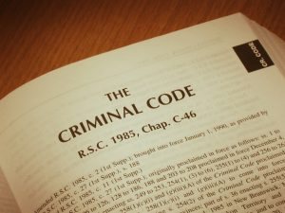
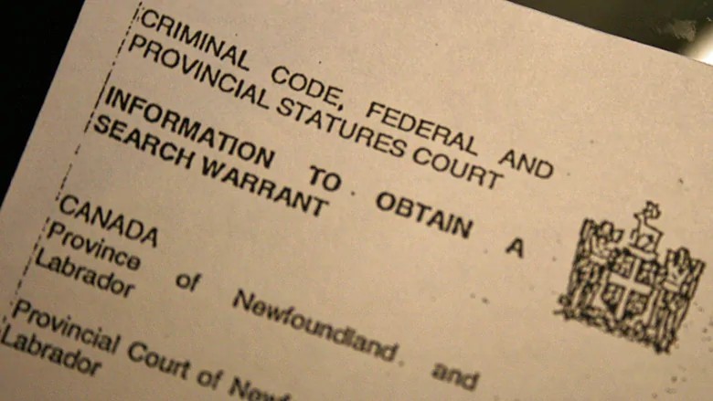
Divisions of Law
Law can be divided into two basic types:
Substantive law
The laws that outline your rights and obligations.
Example: It is a crime to beat up another person.
Procedural law
The legal processes involved in protecting your rights.
Example: The police must follow formal procedures before they can perform a impaired driving test.
Notes:
P.9

Slide 14
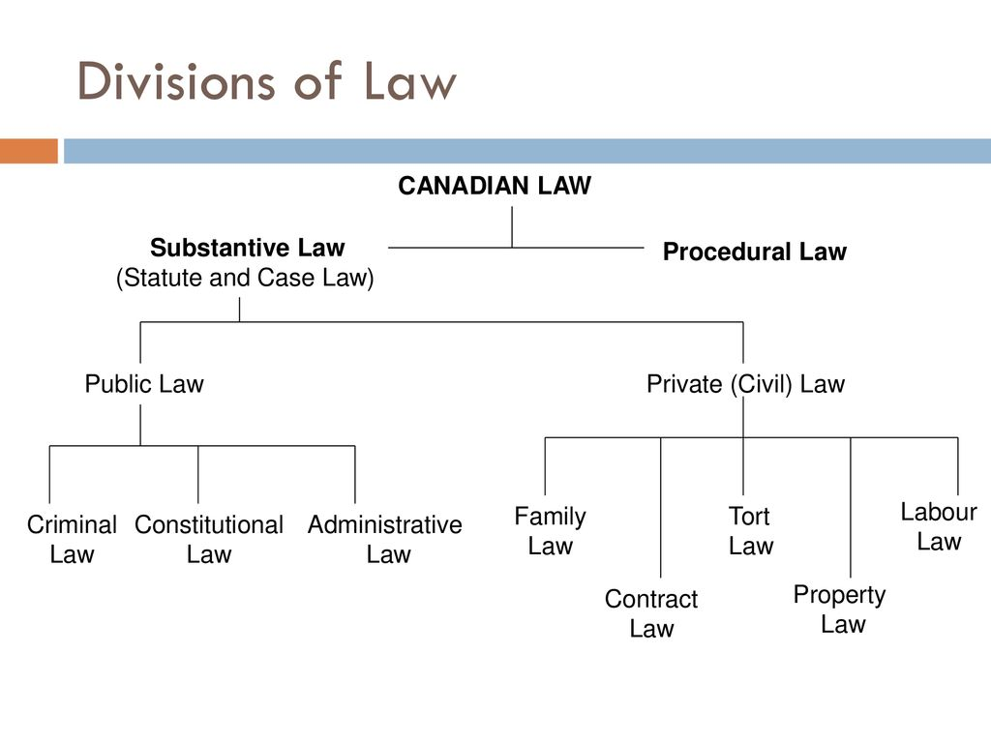
Divisions of Public and Private Law
Notes:
P. 10 & 11: see for definitions of each type of law

Slide 15
Activity 1: Divisions of Law
On a sheet of bristol board, define one of the divisions of law.
Please use photos (hand drawn or printed) to illustrate your division of law.
Make your poster visually appealing by using markers/colours.
Split into 8 groups
Notes:
Put names in a hat to decide who does each topic

Slide 16
Development of Canadian Law
Canadian law is influenced by three different legal systems:
English law: wasn’t written down, came late in England’s history, based on what was done in the past
French law: systematic and coded on paper
Aboriginal legal systems: elected leaders, government by consensus
Notes:
P. 12

