Slide 1
LAW 12
UNIT 1: CHAPTER 1
Part 2

Slide 2
Notes:
P.12

Slide 3
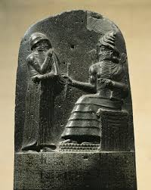
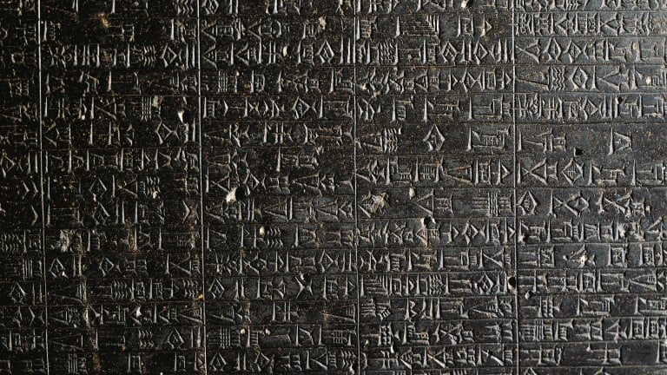
Code of Hammurabi
One of the earliest records of written law.
King Hammurabi of Babylon (now Iraq) had nearly 300 laws carved in columns of stone.
Notes:
P.12

Slide 4
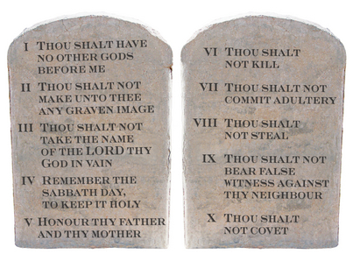
Mosaic Law
The laws Moses gave to the Hebrew people.
The Bible tells the story of Moses getting these laws from God engraved on two stone tablets (the Ten Commandments)
Notes:
p.12

Slide 5
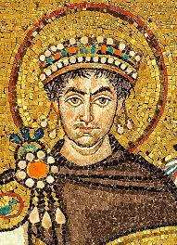
Justinian Code
The Byzantine emperor Justinian codified 1000 years of Roman laws in the Justinian code.
It was a collection of past Roman laws, opinions from legal experts, and new laws enacted by Justinian, and it emphasized equality under the law.
Notes:
P.12

Slide 6
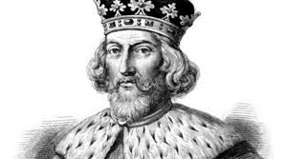
Magna Carta
A famous document that the English nobility forced King John to sign in 1215, because he thought he was above the law.
The Magna Carta recognized the principle of the rule of law, which is the idea that all people - rulers and commoners alike - have to follow the same laws.

Slide 7
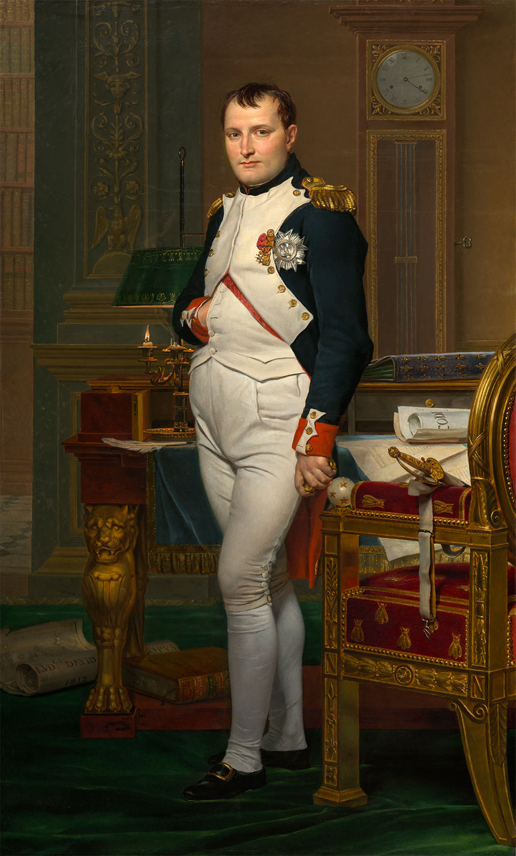
Napoleonic Code
Also called the French Civil Code, the Napoleonic Code was a revised set of civil laws for all French people.
Because Napoleon conquered much of Europe around this time, this new set of laws became the model for many European countries.

Slide 8
Precedent: a legal decision that serves as an example and authority in subsequent similar cases
A precedent is something that has been done before.
Our Canadian legal system relies heavily on precedent, ensuring that similar facts result in similar decisions.

Slide 9
Elements of a Citation
Turn to page 17 in your textbook!

Slide 10
Discussion:
In your discussion groups, read the case that has been assigned to you on page 18.
Answer the questions on loose leaf and submit to Ms. Babstock.
Page 18

Slide 11
Rights and Revolutions
In 1775 the American Revolution broke out and Americans began rebelling against English rule.
They fought for independence from Britain.
The US Constitution was developed and the Declaration of Independence was signed, separating them from British rule.
Afterwards, the French began rebelling against their king.
As a result, the French developed the Rights of Man and of the Citizen.
This became the basis of future modern democracies.

Slide 12
The Universal Declaration of Human Rights
Following the devastation of WWII, the United Nations banded together and developed a Commission on Human Rights to guarantee people certain rights and freedoms.
The Universal Declaration of Human Rights was adopted by the United Nations in 1948.
Turn to page 24 in your text to read the declaration.

Slide 13
The British North American Act
The British North American Act was the first constitution in Canada.
It was signed by the British Government, who were in charge of Canadian law at the time.
Canada was born when this constitution was signed by its original four provinces on July 1st, 1867 - Ontario, Quebec, Nova Scotia and New Brunswick.
At the time, when Britain declared war, Canada was automatically at war.
Canada had little independence since Britain made all the big decisions - the British court was the highest level of court in Canada at the time.

Slide 14
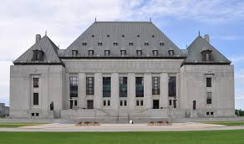
Freedom from Britain
Eventually, Canada assumed more control over its own affairs.
In 1931, British Parliament passed the Statute of Westminster, giving Canada control over its foreign affairs.
When WWII broke out in 1939, Canada was able to declare war on Germany independent of Britain.
The Supreme Court of Canada became the highest level of court appeal.

Slide 15
Canadian Jurisdiction
Jurisdiction: the authority to do something, such as make laws
There are two types of government with jurisdiction in Canada:
Federal
Provincial/Territorial

Slide 16
Federal Provincial
Peace, order and good government
Criminal law
Unemployment insurance
Banking, currency and coinage
Federal penitentiaries
Marriage and divorce
Postal services
Aboriginal peoples and their lands
Property and civil rights
Marriage ceremonies
Police forces and provincial courts
Highways and roads
Provincial jails
hospitals*
*While hospitals are under provincial jurisdiction, the federal government funds them and sets national standards.

Slide 17
Cities and Townships
While the Constitution Act of 1867 established only two levels of government, the provinces gave some of their power to a third level: local municipalities.
Municipalities include:
Cities
Towns
Townships
Villages
Counties

Slide 18
Municipal Governments
Municipal Governments can make laws that govern the activities of a local community, called bylaws.
Some examples of municipal bylaws:
Emergency services
Building permits
Lawn care
Etc.

Slide 19
Research
What are some bylaws in Mackenzie?
Make a list of the bylaws you find with a partner.
What bylaws were surprising/new to you?
Grab a laptop!

Slide 20
Three Branches of Government in Canada
Branches: | Federal | Provincial
Executive | Governor General (monarch) Prime Minister Federal Cabinet Civil Service | Lieutenant Governor (monarch) Premier Cabinet Civil Service
Legislative | Parliament Governor General (monarch) House of Commons Senate | Provincial Legislature Lieutenant Governor (monarch) Elected House
Judiciary | Federal Judiciary | Provincial Judiciary

Slide 21
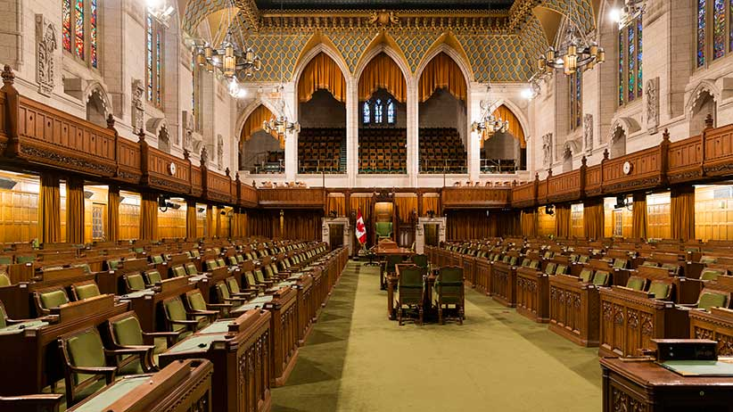
How Laws are Made
Before a law becomes a law, it is proposed as a bill.
Then, there are many stages and government officials involved in passing the law.

Slide 22
Passage of a Bill into Law (Federal)
Who: | Stage:
House of Commons | First Reading Bill introduced by a Cabinet minister or private member First vote taken Second Reading Bill introduced again and debated in general Second vote taken Third Reading Bill briefly debated Third vote taken
Senate | Bill goes through three readings and committees, as in the House of Commons
Governor General | Signs bill to become a law (royal assent)

Slide 23
Chapter 1
Read the ISSUE titled:
Mediation: An Effective Form of Dispute Resolution?
Answer questions 1&2 on loose leaf and submit to Ms. Babstock.
You may work in pairs.
ISSUE: Page 32-33

Slide 24
REVIEW
Page 32-35
Questions: 1, 5, 6, 7, 13, 14
Submit to Ms. Babstock on loose leaf
Notes:
Get a copy of the code of conduct.

