Slide 1
LAW 12
Unit 2: Criminal Law
Chapter 4: Introduction to Criminal Law

Slide 2
Chapter Terms:
Actus reus
Criminal Code
Criminal offense
Criminalize
Decriminalize
Hybrid offense
Impartiality
Indictable offense
Legalize
Mens rea
Prosecute
Prosecute
Summary conviction offense
Notes:
Complete on loose leaf and then read page 113

Slide 3
Four Conditions to be Considered a Crime
The actions or behaviour of the person must be considered immoral or wrong by most Canadians.
The person’s actions must cause harm to society and any individual victims.
The harm caused by the person’s actions must be serious.
The person must be punished by the criminal justice system for his or her actions.

Slide 4
Legal vs Illegal vs Criminal
Legal: | Illegal: | Criminal:
Dying your hair blue Wearing religious clothing Drinking alcohol when you turn 19 Smoking marijuana when you turn 19 Using a cell phone in a movie theatre Protesting with pickets | Purchasing cigarettes under the age of 19 Speeding Drinking in public Cutting down certain types of trees | Theft Assault Possessing cocaine Kidnapping trespassing

Slide 5
The Purpose of the Criminal Justice System
To protect people from harm
To enforce moral standards based on the norms and beliefs of Canadians
To maintain order in society
To protect property from harm
To provide retribution (punishment)
To provide rehabilitation (help them reintegrate into society)
To deter people from committing crimes

Slide 6
Principles of Justice
Fairness: the process must be impartial toward the accused. Also, similar cases must be treated alike and different cases differently. The courts must consider the facts and circumstances of each case.
Efficiency: the process must be timely.
Clarity: the accused must understand the charges and the process.
Restraint: Government officials must show self-discipline in their treatment of the accused.
Accountability: Government officials must be held responsible for their actions.
Participation: the accused must be able to play an active part in the process and the process must be open to public scrutiny.
Protection: to guard the accused from harm, all government officials must be regulated.

Slide 7
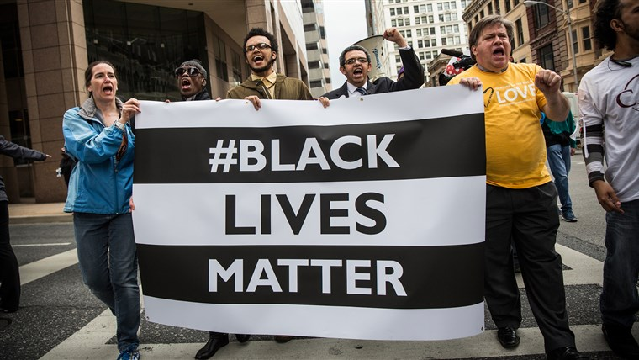
Fairness and Equality
The United Nations and Amnesty International note that Canada still has some issues with fairness and equality in the justice system.
Racial profiling by police
Treatment of Aboriginal peoples
Gender inequality
Unequal distribution of our nation’s wealth

Slide 8
Review Your Understanding
Please answer the following questions on loose leaf and submit to Ms. Babstock.
Page 118
Questions: 1, 2, 5

Slide 9
Criminal Code
Criminal law is made into a law by a democratically elected federal Parliament.
When a law is made, it is enacted.
When a law is changed, it is amended.

Slide 10
Public Law
Canadian criminal law is public law.
Criminal law is made by the federal government, and therefore is public.
Criminal law is also public law because it concerns the actions of the government against an individual.
When someone is prosecuted, they are brought to trial by the Crown attorney.
The Crown attorney represents the government, which in turn represents the beliefs of the people of the country (us).

Slide 11
Limits, Duties and Rights of Individuals
The Criminal Code restricts what an individual can do (steal, assault someone, use narcotics, etc.)
The Criminal Code identifies specific duties that an individual must do. If an individual fails to carry out these specific duties, (ex. Failing to care for a newborn baby), he or she is criminally responsible.
Limit
Duty
Right
The Charter states what an individual is free to do (the right to liberty, the right to not be arbitrarily detained, and so on.)

Slide 12
Summary Convictions vs. Indictable Offenses
If you have ever watched American crime TV shows, you may be familiar with the terms:
Felonies: serious crimes
Misdemeanors: less serious crimes
In Canada, we use these terms:
Indictable Offenses: serious crimes
Summary Convictions: less serious crimes

Slide 13
Summary Conviction Offenses
Under the Criminal Code, the maximum penalty for most summary conviction offenses is:
A fine of $5000 and/or
6 months in jail
There is a 6 month period for laying a charge for a summary conviction offense.
This means a person must be charged within 6 months of the crime or he/she is free and clear.
A provincial court judge hears the evidence and gives a verdict.

Slide 14
Summary Conviction Offenses
Causing a disturbance
Taking a motor vehicle without the owner’s consent
Reckless driving
Harassing telephone calls
Public nudity
Disturbing religious worship
stopping/impeding traffic for prostitution
Falsifying employment record
Improper use of military uniform
Possession of a category II drug (marijuana resins)
Examples

Slide 15
Indictable Offenses
Under the Criminal Code, the maximum penalty for an indictable offense is set for each different offense.
Ex: Manslaughter maximum penalty: life in prison
The trial judge ultimately decides time served for these offenses
Unlike summary conviction offenses, there is no statute of limitations for indictable offenses.

Slide 16
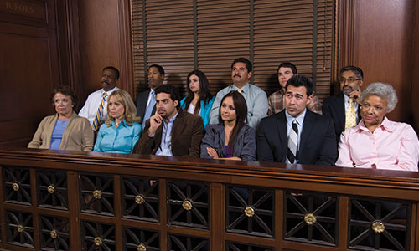
Indictable Offenses Cont.
For an indictable offense, the accused can choose to be tried by:
Provincial court judge alone
A judge of the superior court of the province/territory alone
A judge of the higher court with a jury

Slide 17
Indictable Offenses
Murder (1st & 2nd degree)
Treason
Piracy
Hijacking
Manslaughter
Attempted murder
Sexual Assault
Kidnapping
Human trafficking
Robbery
Arson
Drug trafficking
making/distributing child pornography
Examples

Slide 18
Hybrid Offenses
Most offenses defined by the Criminal Code are hybrid offenses and can end up as either summary conviction or indictable offenses.
The Crown attorney ultimately decides if the offense can be lessened to a summary conviction based on:
Previous record of the accused
The date of the offense (6 months in the past cannot be summary conviction)
Whether the lesser penalty is an appropriate punishment.

Slide 19
Hybrid Offenses
Impaired driving
Assault
Public mischief
Theft under $5000
Examples

Slide 20
Review Your Understanding
Complete these questions on a sheet of loose leaf and submit to Ms. Babstock.
P. 123
Questions: 1, 2, 3, 4, 5

Slide 21
Elements of a Criminal Offense
“Actus non facit reum nisi mens sit rea”
Loosely translated, this means “the act will not make a person guilty unless the mind is also guilty”
Basically, you must consciously intend to commit a crime; you cannot commit a crime by accident or unknowingly.

Slide 22
Mens rea
Turn to page 124 in your text and read the case with a friend or by yourself.
Answer the questions 1-4 on p. 125 and submit to Ms. Babstock :)
Case Study

