Slide 1
LAW 12
Chapter 5: The Police

Slide 2
Chapter Terms:
Accused
Appearance notice
Arrest
Bail hearing
Citizen’s arrest
Custody
Detain
disclosure
Evidence
Plea negotiation
Preliminary hearing
Reasonable and probable grounds
Search
Search warrant
warrant

Slide 3
Read & Discuss
P. 145: Introduction

Slide 4
Limits on Police Behaviour
Limits are placed on police officers and the actions they can do to arrest someone.
Firstly, and most importantly, they must obtain a search warrant before conducting a search.
In order to get a search warrant, they must apply to a judge or justice of the peace and be able to show reasonable and probable grounds.
Reasonable and probable grounds must be based on evidence, and not be random, impulsive, or based on a hunch.

Slide 5
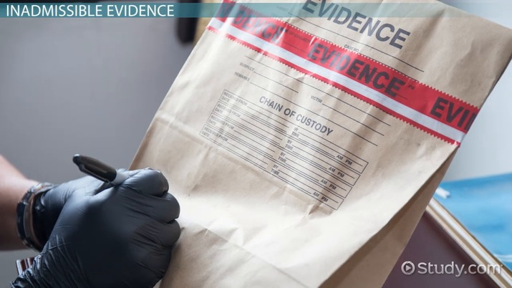
Search Warrants at Trial
At the trial, a judge may decide that the evidence presented was obtained unlawfully.
If the judge decides that the evidence was collected unlawfully, they will determine that the evidence was inadmissible.
Evidence can be deemed inadmissible if it was collected without a search warrant or if it is in violation of the Charter.

Slide 6
Arrest
If the police think a suspect has committed a crime, they cannot arrest them unless they have proven reasonable and probable cause.
If they are able to prove reasonable and probable cause, they can do 1 of 3 things:
Issue an appearance notice
Arrest the suspect
Obtain a warrant for arrest

Slide 7
Know your Rights!
Fun fact: If you ever get arrested, you are only required to give them your name and address of residence!

Slide 8
Appearance Notice
If the police believe the accused is not a threat to society, and that they will show up at a bail hearing, they will not arrest the suspect immediately.
They issue an appearance notice for summary conviction offenses and less serious indictable offenses.
The officer then has to swear a complaint under oath that a crime has been committed.

Slide 9
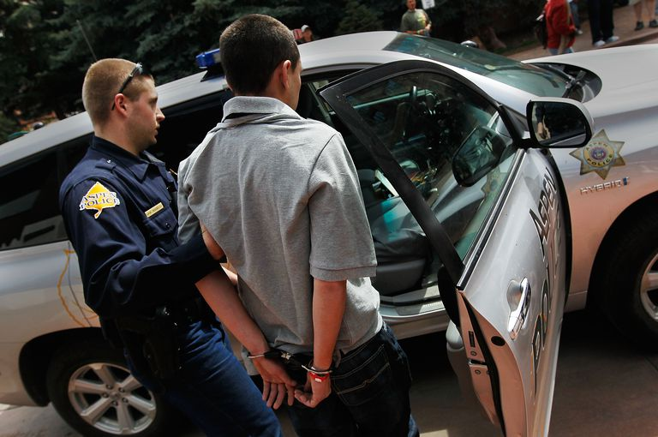
Arresting the Suspect
For more serious indictable offenses where the suspect may be a threat to society, the police officer may arrest them on the spot.
Any officer can arrest someone without a warrant if they are believed to be a threat, they may run away or they may commit another offense.

Slide 10
Miranda Rights
In American crime TV shows, you may be familiar with the phrase “you have the right to remain silent. Anything you say can and will be used against you in a court of law….. “
These statements are known as Miranda rights and are read to every suspect upon arrest.
In Canada, we have a similar process that’s known as reading the caution to the accused.

Slide 11
Steps in a Lawful Arrest
Notice on arrest: “I am Police Constable Babstock”
Advising the accused that they are under arrest, and the offense charged: “I am arresting you, Devon Dyer, for the murder of Julian Clattenburg”
Caution 1, right to counsel: “It is my duty to inform you that you have the right to rend instruct counsel without delay. Do you understand?”

Slide 12
Steps in a Lawful Arrest Cont.
4. Caution 2, right to remain silent: “You are charged with first degree
murder. Do you wish to say anything in answer to the charge? You are not obligated to say anything unless you wish to do so, but whatever you say may be given in as evidence.”
5. Physically touching the accused to signify custody: handcuffs.

Slide 13
Resisting Arrest
If the accused resists arrest, the police have the legal authority to use “as much force as necessary” to prevent an escape.
At the trial, the judge will determine whether a reasonable amount of force was used to arrest the accused.
In certain cases, the police are allowed to use serious or deadly force.
The behaviour of the suspect might cause serious harm or death to others
The suspect flees to escape arrest
There are not alternative means to prevent escape

Slide 14
Warrant for Arrest
If the police have difficulty finding the accused, police can go before a judge or justice of the peace and request a document called a summons.
The summons is then delivered to the accused by a sheriff or deputy.
If the police can prove to the judge that the accused will not appear in court voluntarily, the judge will issue an arrest warrant.

Slide 15
Citizen’s Arrest
A regular citizen can make an arrest if they witness a crime or believes a person has committed one.
The arresting citizen can not use excessive force, and must surrender the suspect to the police as soon as possible.
The arresting citizen must state clearly that they are placing the suspect under citizen’s arrest.
If the arresting citizen acts in an unreasonable way, they can be sued.

Slide 16
You be the Judge
P. 149
Read and discuss

Slide 17
Role Play
Scenario 1: Arrest for murder. Suspect is compliant.
Scenario 2: Arrest for assault. Suspect is resisting arrest.
Scenario 3: Citizen’s arrest for theft. Suspect is compliant.
Split into groups of 3

Slide 18
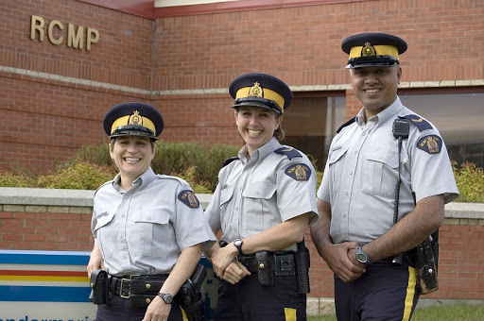
Duties of Police Officers
Crime prevention
Law enforcement
Assistance to victims of crime
Maintenance of public order
Emergency response
Investigations of crime

Slide 19
Branches of Police in Canada
Royal Canadian Mounted Police: federal
USA equivalent: FBI
Ontario Provincial Police: provincial
USA equivalent: State troopers
Vancouver Police Department: municipal police
Only work within the city’s boundaries
In all other small municipalities that are not big enough to employ their own police force, the RCMP or OPP act as municipal police.

Slide 20
Principles of Canadian Police Services
The need to ensure the safety and security of all persons and property
The importance of safeguarding the fundamental rights guaranteed by the Canadian Charter of Rights and the various provincial human rights laws
The need for cooperation between the providers of police services and the communities they serve
The need to be sensitive about the pluralistic (diverse) and multicultural character of our society
The need to ensure that police forces are representative of the communities they serve

Slide 21
You be the Judge
P. 151
Read and discuss

Slide 22
Upon Arrest
Police officers may:
Search the accused for any potential evidence
May involve a strip search, frisk, or body search if drugs are involved
DNA tests
Provide blood, urine, breath samples
Polygraph tests
The accused may refuse all these tests without a warrant from a judge, except in the case of suspected impaired driving.

Slide 23
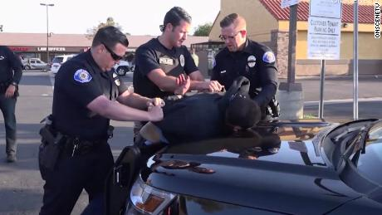
Legal Rights and Search Laws
One of the most important rights in Canada: the right to privacy.
Section 8 of the charter states that everyone has the right to be secure against unreasonable search or seizure.
Police cannot search you, your property, record you speaking, or seize your property without probable and reasonable grounds to do so.

Slide 24
Police Search - Reasonable Cause
Police cannot search you based on a hunch
Police may search a person if they believe they are carrying a concealed weapon.
This is called “police search incident to arrest”
Other than that, police may not even ask you your name or make you stand still.
The only exception to this is when you are pulled over while driving a car.

Slide 25
Police Search: Traffic Stop
If a police officer pulls over your vehicle, you are required to show them:
Your driver’s license
Registration and insurance
Police may also assess the mechanical functions of your car
Broken lights
Flat tires
Excessive smoke coming from the engine
Etc.

Slide 26
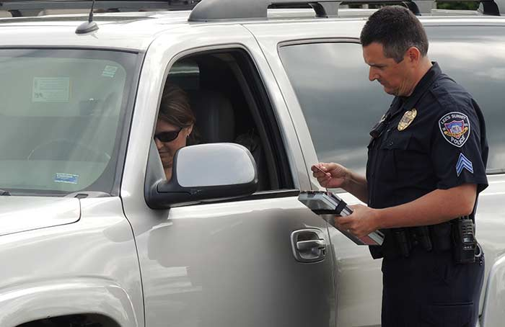
Police Search: Traffic Stop cont.
However, the police MAY NOT search items that are not of clear interest to them.
They may ask you what’s inside your duffle bag, but they may not open it and search without a warrant.

Slide 27
You be the Judge
P. 156
Read and discuss

