Slide 1
LAW 12
U2CH5 P2

Slide 2
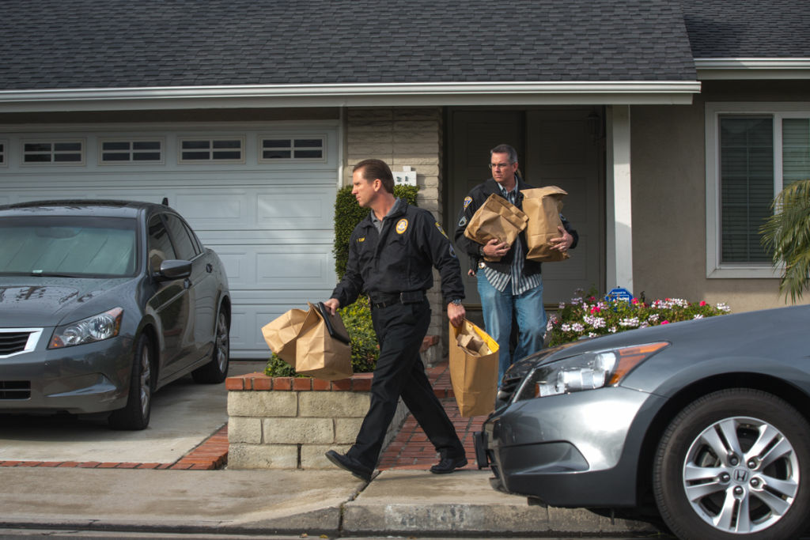
Rights on Being Searched
Once a person has been arrested, police may wish to search that person’s residence.
Police can only enter the residence with a search warrant.
A search warrant is a legal document that gives them the authority to search.

Slide 3
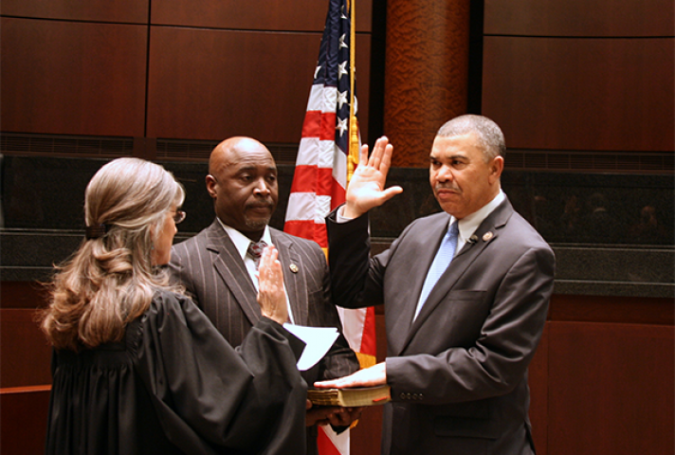
Obtaining a Search Warrant
Before a search warrant can be issued, the police must stand before a judge or justice of the peace and swear that a crime has been committed.
The must also have reasonable grounds to believe that evidence of the crime exists on this person’s property.
If the officer’s testimony is accepted, a warrant will be issued to search the property.

Slide 4
Search Laws and Rules
Police can demand to enter a property when they have a search warrant.
If entry is refused, or if there is no one home, the police can force entry onto the property.
Police can be held liable if “excessive” force is used.
Ex: if they shot the door handle off the house, only to find out the door was not locked in the first place.

Slide 5
Search Laws and Rules cont.
If a person answers the door, they have the right to ask the police to see the search warrant before allowing them to enter the property.
If the document is not correct in every detail (ex: the date, the name, the address) the person has the right to refuse entry to the police officers.
Once inside the property, police can only search individuals on the property if they have reasonable cause to arrest them, or if there is suspected illegal drugs.

Slide 6
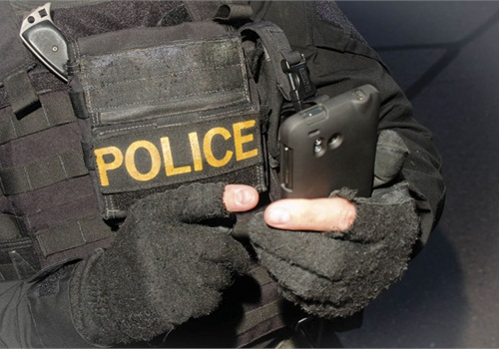
Telewarrants
Telewarrants are a new form of warrants that can be obtained via telephone, fax or email.
Telewarrants were created for searches that take place in remote areas in Canada where visiting a judge or justice of the peace could take several days.
Telewarrants have enhanced police powers as they can be obtained very quickly.

Slide 7
Exceptions to Search Laws
The police may search any area that is not a private residence if there is reason to believe that there are illegal drugs on the premises without a search warrant.
Anyone inside these premises may also be searched without a warrant.
These types of searches usually take place as a surprise entry.
Police may also search an area without a search warrant if there is reason to believe there may be illegal weapons present (ex: a person’s car)
However, the officer must be able to prove reasonable cause for search to a judge.

Slide 8
You be the Judge
P. 159
Read and discuss

Slide 9
Rights on Being Detained
Section 9 of the Charter states that everyone has the right not to be arbitrarily detained or imprisoned.
The only case where police can stop and question you is when you are driving.
If a police officer says they would like to speak to you for a few minutes, you have been detained, but not arrested, and are not required to answer any questions.
You can actually just keep on walking and say, “sorry officer, I do not wish to answer any of your questions.”

Slide 10
Rights on Being Detained cont.
Detention should either lead quickly to an arrest, or the person should be free to go (seconds or minutes)
If you refuse to answer any questions, the police are required to let you go.
Sometimes an officer will continue to question an uncooperative individual. That person should immediately:
Request to speak with a lawyer
Write down the officer’s badge number
Collect names of any witnesses

Slide 11
You be the Judge
P. 161
Read and discuss

Slide 12
Rights on Being Arrested
An accused’s request to contact a lawyer must be granted immediately.
If the accused does not have their own lawyer, one will be provided who works for the government. This is called a criminal defense lawyer.
The accused can refuse to answer any questions without a lawyer present with the exception of:
Name
Address
Occupation
Birthday

Slide 13
Rights on Being Arrested cont.
If you are arrested or detained, you must be told the reason right away.
Police cannot put you in cuffs and tell you they just want to talk without telling you what the charges are.
Police must also refrain from asking you any questions until your legal aid arrives.

Slide 14
You be the Judge
P. 163
Read and discuss

Slide 15
Release and Bail Procedures
After being arrested, you may be released on the spot if:
The police determine you are not a threat to society
They have reason to believe you will appear in court on the agreed date
Others may be taken to the police station for fingerprints and photos.
If the police believe the accused is a threat or may not appear in court, they may be detained until their bail hearing.

Slide 16
Bail Hearings
Accused persons must be brought before a judge or justice of the peace for a bail hearing within 24 hours.
Bail is money of property guaranteed to the court to ensure that the accused will appear in court at a later date.
If the person does not appear in court, the bail money or property will be lost.
If the accused is determined a flight risk, the bail will be denied and the person will be detained until their court hearing.

Slide 17
Judicial Release Procedures
If the accused is released, they are required to sign an undertaking and live up to the conditions set out by the court.
These conditions could be:
A curfew
Orders not to associate with certain friends
Orders to avoid certain places
Having to report to the police station once a week
These orders help prevent the accused from committing another offense while waiting for their hearing.

Slide 18
Release Denied
If the accused is denied bail, they can appeal their case to a higher court.

Slide 19
You be the Judge
P. 166
Read and discuss

Slide 20
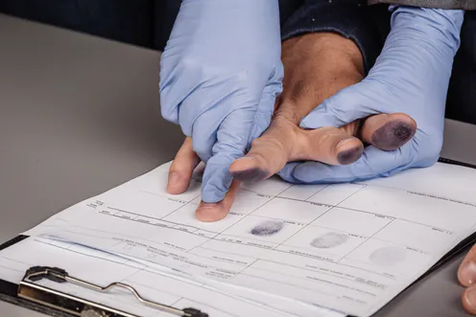
Fingerprints, Photographs, and Biometrics
People who are charged with indictable offenses and are released on bail may be required to provide fingerprints and photographs before being released.
If the person is acquitted of the crime, they do not have the right to have these records removed from police files.

Slide 21
Awaiting Trial
The accused should consult a criminal defense lawyer and disclose all information regarding the crime before the trial.
If the accused discloses that they did in fact commit the crime, the lawyer cannot stand before a judge and say their client is innocent.
To prepare for trial, the judge may:
Interview witnesses
Examine previous court decisions on similar offenses
Gather background info on the case
If there is a disagreement, the accused can request a different lawyer.

Slide 22
DNA Evidence
P. 169-170
Read and discuss

Slide 23
You be the Judge
P. 171
Read and discuss

Slide 24
Agents of Change
P. 172
Read and discuss

Slide 25
Court Appearances
Provincial Courts:
Summary conviction offenses and minor indictable offenses (theft, fraud, and mischief, all under $5000)
More serious indictable offenses (assault, sexual assault, and weapons offenses); judge alone without a jury
Provincial Superior Court:
The most serious indictable offenses (listen in section 469 of the criminal code including treason, murder, and piracy); judge and jury
More serious indictable offenses (assault, sexual assault, weapons offenses); judge alone without a jury, or judge and jury

Slide 26
The Plea
Someone charged with committing a criminal offense enters a plea in provincial court.
The charge is read in court and the person pleads guilty or not guilty.
About 90% of Canadians plea guilty.

Slide 27
Provincial Court System
P. 174
Read and discuss

Slide 28
Chapter Review
Questions: 1, 2, 3, 5, 7
P. 178-179

