Slide 1
LAW 12
U2Ch6: Trial Procedures Part 1

Slide 2
Key Terms
Adversarial system
Challenge for cause
Circumstantial evidence
Credibility
Crown attorney
Defense counsel
Direct evidence
Hung jury
Jury panel
Oath
Peremptory challenges
Perjury
Sequester
Voir dire

Slide 3
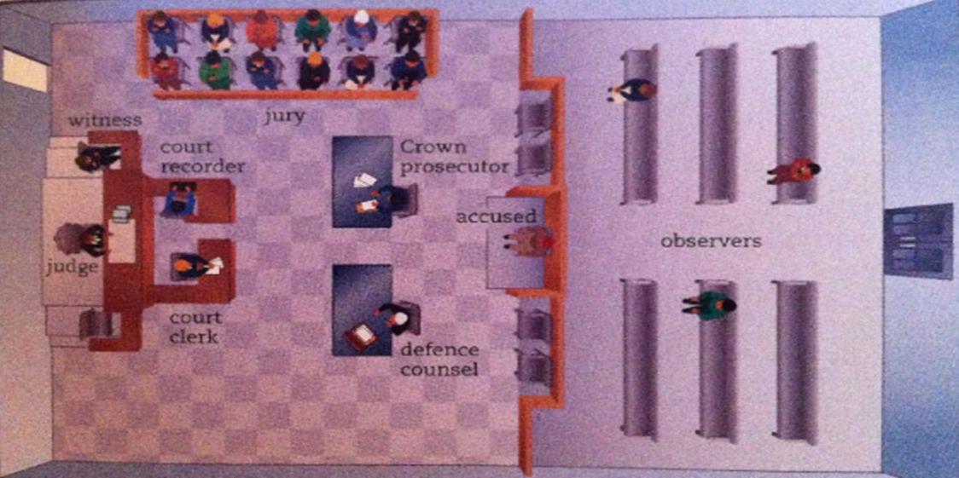
Courtroom Organization
Canadian trial procedures are adapted from English law and are ______________
_______________
_______________
_______________
_______________

Slide 4
The Judge
Judges are often referred to as ____________________________________________.
Judges are appointed by the _______________________________________________.
Judges are paid by the _______________________________________________________.
Judges are chosen among lawyers who have __________________________________.
Judges must act ______________________________________________________________.
One of the most important role of the judge is deciding ________________________________________________________________________________.

Slide 5
Justice of the Peace
Have less power than ______________________________________.
May preside over the court of first appearance where the charge against the accused is read.
Most bail hearings occur before a ______________________________.
May also issue __________________________________.
May conduct trials for municipal bylaw offenses and some provincial laws such as _____________________________________.

Slide 6
The Crown Attorney
The lawyer who prosecutes on behalf of the government and society.
Their job:
_______________________________________________________________________.
________________________________________________________________________.
Crown attorneys spend a lot of time working with police to gather evidence.

Slide 7
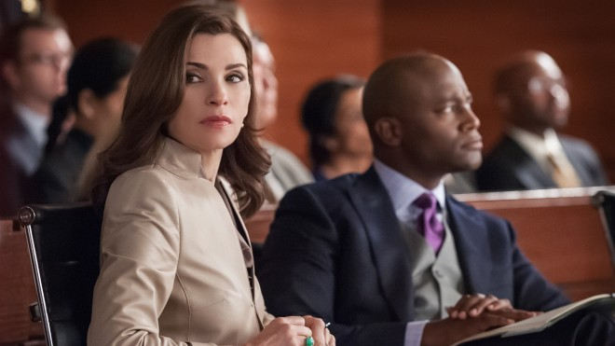
The Defense Counsel
The legal representative of the accused.
Their job:
__________________________________________________________________________.
__________________________________________________________________________.
__________________________________________________________________________.
__________________________________________________________________________.

Slide 8
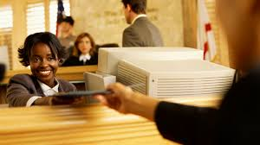
The Court Clerk
The person who keeps records and files, and ______________________________ _____________________________________________________________________________ .
They also:
Read out the charge against the accused
Swears in witnesses
Handles evidence
Does most of the paperwork
Other “routine tasks” required by the court

Slide 9
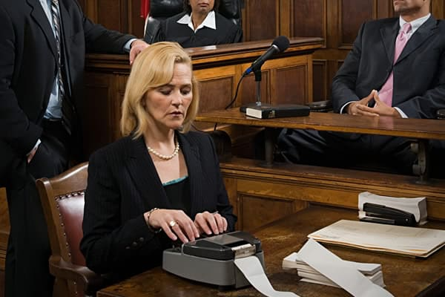
The Court Recorder
A person who _________________________________.
This person sits near the witness stand to record, word for word, all evidence given and all questions asked and comments made during the trial.
Court recorders use shorthand machines, special computers or verbally input all the speech in the courtroom.
The court relies on these documents to be exact as the transcripts are then referenced later if the case is appealed.

Slide 10
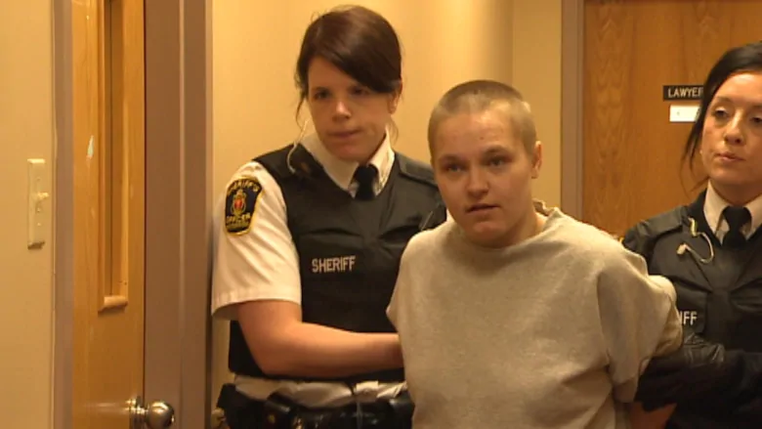
The Sheriff
A Crown-appointed official who acts as a part of the justice administration system.
The sheriff and their deputies carry out much of the court administration process, such as
Making sure the accused appears in court
___________________________________________
Assist the judge
_________________________________________________
Seizing and/or selling property to settle claims for damages

Slide 11
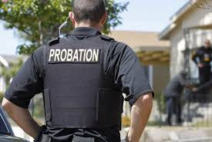
Other Court Officials
Some other officials that may appear in court:
____________________________________________________________________
____________________________________________________________________

Slide 12
Juries and Jury Selection
A jury system is not perfect, but it usually satisfies the public more so than a judge alone.
A jury allows the public to see a judgement made by their peers.
A jury can be very expensive, so they are usually only used for ___________________________________________________________________________.
Cases that are very technical in terms of laws may be better heard by a ______.
Cases that involve a fact situation that a jury would find sympathetic would be best heard in front of a ________________________.

Slide 13
Jury Selection
Empanelling is the process of selecting _______________________________________.
A list of jurors is selected randomly by names of eligible voters in the area of the court.
A selection committee headed by the sheriff then randomly picks _____________ names and this group becomes the jury panel.
The jury panel must appear before the sheriff where they decide if each person is a reasonable juror.
If any bias or opinions about the case are evident, the person will be removed from the panel.

Slide 14
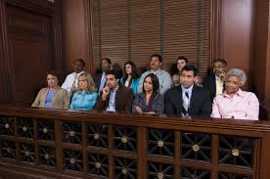
Jury Selection cont.
Prospective jurors must have the following qualifications:
Canadian citizen
____________________________________________
Must have resided in the province or territory for at least a year
_____________________________________________________
Must be mentally fit for the responsibility

Slide 15
Exempted from Jury Duty
Jurors are expected to be average citizens with no particular knowledge or skill in law.
Some common people who get exempted from jury duty include:
Members of government of any level
_________________________________________________________________________
Doctors, coroners, veterinarians
Law enforcement officers, including prison wardens and their spouses
____________________________________________________________________________
People with mental or physical disabilities
____________________________________________________________________________
Anyone convicted of an indictable offense that has not been pardoned

Slide 16
Jury Exemption
If you have been summoned to serve on a jury panel, you may be excused if:
You have a personal interest in the case
________________________________________________________________________
You have a personal hardship such as a surgery or illness
__________________________________________________________________________
You are a student writing exams during the trial period
____________________________________________________________________________

Slide 17
Challenge of the Jury List
Either side can challenge the validity of the jury list, but this is rarely done.
The jury list may be challenged if:
__________________________________________________________________________.
__________________________________________________________________________.
A lawyer may also question jurors on their racial beliefs.
If a juror is challenged, two other jurors will be appointed to decide if the juror in question is fit to serve on the trial.

Slide 18
You be the Judge
P. 191
Read and discuss

Slide 19
Peremptory Challenge
A formal challenge to a potential juror for no specific reason.
Each side is allowed a set number of peremptory challenges based on the charge:
Very serious charge, such as first degree murder - _____________________
A charge where the penalty is five years or more - ______________________
A charge where the penalty is five years or less - ________________________
If not enough jurors remain after the challenges, a prospective juror may be summoned off the streets by a sheriff.

Slide 20
Offenses Allowing Trial by Jury
Murder
____________________________
Alarming Her Majesty
__________________________________________________________________________
Bribery by the holder of a judicial office
___________________________________________________________________________
Piracy or piratical acts
________________________________________________________________________
Attempting or conspiring to commit any of the above offenses
___________________________________________________________________________
Do some of these seem outdated? Why are they still in the criminal code?

Slide 21
You be the Judge
P. 192
Read and discuss

Slide 22
Jury Duty
After being selected, each juror is sworn in and then sits in the jury box.
The judge will then inform the jurors of their duties.
The jurors may take notes if they wish.
The jurors may not:
____________________________________________________________________________
____________________________________________________________________________
Disclose any information from jury discussions that is not revealed in open court even after the conclusion of the trial

Slide 23
Juror’s Oath
“I swear to well and truly try and true deliverance make between our sovereign lady and the Queen and the accused at the bar, whom I have in charge, and a true verdict give, according to the evidence, so help me God.”

Slide 24
Juror’s Pay
Serving Jury Duty is part of one’s civic duty, and as such, a juror may not be paid.
Jurors are entitled to token payment for their services if the trial is lengthy.
Pay varies from province to province.
As of 2008 in Ontario, jurors get $40 per day increasing to $100 per day if the juror is required to serve for 50 days or more.
Travel expenses are granted to people travelling more than 40 kms to court.

Slide 25
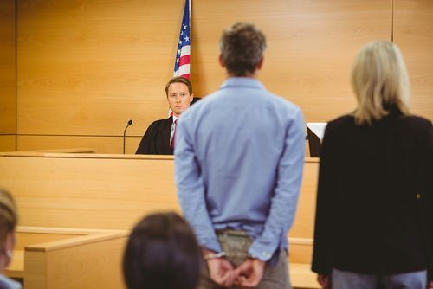
Arraignment
The first step in a trial is the _____________________.
This is when the charge is read by the court clerk.
The arraignment must include a formal document that states the charges being laid against the accused, called an indictment. If this is not present, an an acquittal may result.
The accused then enters a plea of ____________________________________.
If the accused refuses to plea, a not-guilty plea will be entered on their behalf.

Slide 26
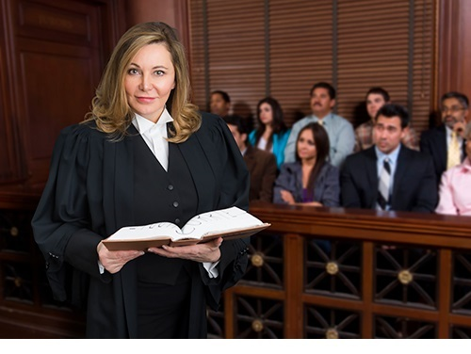
Crown Evidence
According to section 11(d) of the Chater, a person is innocent until proven guilty.
It is the Crown’s responsibility to disprove this and to__________________________
_______________________.

Slide 27
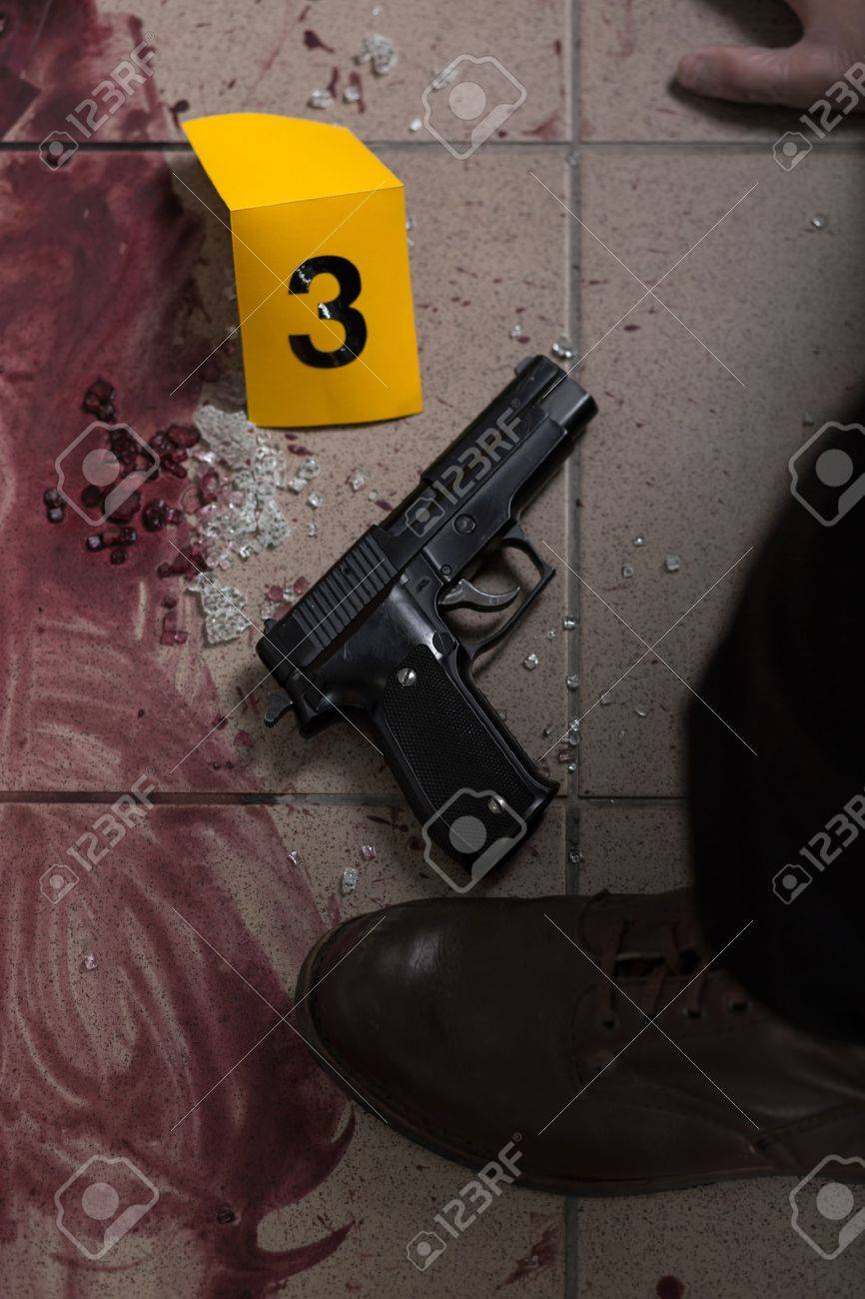
Crown - Opening Statement
The Crown first provides an opening statement that summarizes the case against the accused.
The Crown may use exhibits such as:
_______________________________________________
_______________________________________________
The Crown must ensure that all exhibits presented are reliable, relevant and fair, or the exhibits may be deemed inadmissible by the judge.

Slide 28
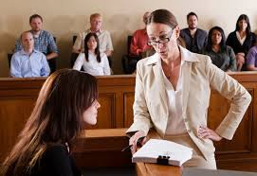
Crown - Direct Evidence
Direct evidence is usually testimony from a witness who saw the offense happen.
Of course, in some cases, there may be no witnesses present.
Witness testimony can be unreliable though, because:
_________________________________________
_________________________________________

Slide 29
Crown - Circumstantial Evidence
Circumstantial evidence is indirect evidence that proves that the accused is most likely the person who committed the crime.
Example: A glove was found at the scene of the crime, and the accused owns the other glove. The circumstances prove that the accused was most likely at the scene of the crime.
Additionally, DNA tests can be used to link the accused to items at the crime scene.
It is the judge and jury’s decision to consider the evidence and decide which piece of evidence is the most convincing.

Slide 30
Crown - Direct Examination
Also known as the examination-in-chief, direct examination is the first questioning of the witness called to the witness stand.
The crown may not ask leading questions which produce a yes or no answer.
Example:
Did you see the accused driving a yellow car Aat 1:24 am? (leading question)
_____________________________________________________________ (non-leading questions)

Slide 31
Cross Examination
After the direct examination is over, the opposing lawyer (the defense) can then cross examine the same witness.
The defense is now allowed to use leading questions which produce a yes or no answer.
It is the responsibility of the judge and jury to now decide which argument was more convincing.
If the Crown wishes, they may cross-examine the witness again before they step down.

Slide 32
Defence Evidence
It is the responsibility in the defense to poke holes in the Crown’s evidence.
The defense does not have to prove innocence, but rather prove that the Crown does not have enough evidence to charge the accused.
The defence can now bring forth its own witnesses, and now the defense may not ask any leading questions.
The Crown can cross examine the defence’s witness, and may ask leading questions.

Slide 33
Steps in Presenting Evidence
____________________________________________________________________________
____________________________________________________________________________
____________________________________________________________________________
Defense may re-cross-examine the witness with judge’s permission
____________________________________________________________________________
Crown may cross-examine witness
____________________________________________________________________________
Crown may make a rebuttal
____________________________________________________________________________

