Slide 1
LAW 12
Chapter 7 Part 1

Slide 2
Key Terms
Assisted suicide
Assault
Break and enter
Controlled substance
Fraud
Homicide
Manslaughter
Murder
Robbery
Sexual assault
Soliciting
Street racing
theft

Slide 3
Criminal Code Offenses
Under the Constitution Act, 1982, criminal law is a _______________________.
This is why all offenses are treated the same across Canada, versus the U.S. where each state developed its own set of guidelines.
Example:
A person in Canada who committed murder would get sentenced to life in prison, no matter what province it occured in.
In the U.S., if a person committed murder, they would be sentenced to death in Texas, and in Michigan they would get life in prison.

Slide 4
Parts of the Criminal Code
The Criminal Code is subdivided into parts that specifically outline criminal offenses by category.
Part I: General
Part II: Offenses against Public Order
Part III: Firearms and Other Weapons
Part IV: Offenses against the Administration of Law and Justice
Part V: Sexual Offences, Public Morals and Disorderly Conduct
Part VI: Invasion of Privacy
Part VII: Disorderly Houses, Gaming and Betting
Part VIII: Offences against the Person and Reputation
Part IX: Offences against Rights of Property
Part X: Fraudulent Transactions
Part XI: Willful and Forbidden Acts in Respect to Certain Property
Part XII: Offences Relating to Currency

Slide 5
Violent Crimes
Violent crimes include offences against the person and reputation, or Part VII of the Criminal Code.
As the name suggests, violent crimes are violent in nature and cause _______________________________________________________________.
Violent crimes also include hate crimes that are directed at a person's’ reputation.
There are 6 types of violent crimes in Canada: ________________________________________________________________________________.

Slide 6
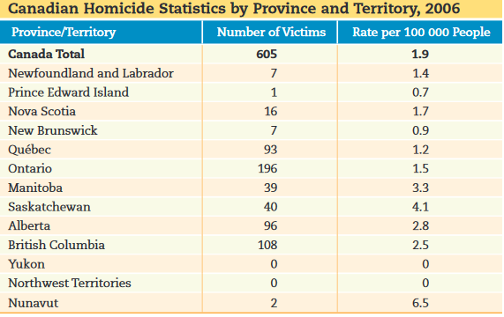

Slide 7
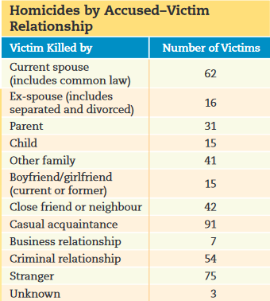
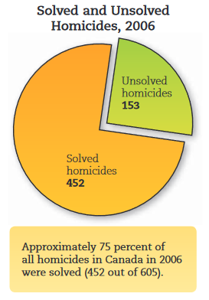

Slide 8
Homicide
Killing another human being, directly or indirectly, is defined as homicide in the Criminal Code.
Homicide and either be __________________________________________________.
_________________: happens when a person causes the death of someone else on purpose or because of recklessness.
______________________: when the death is a complete accident and there is no one to blame. (this is not a criminal offence)

Slide 9
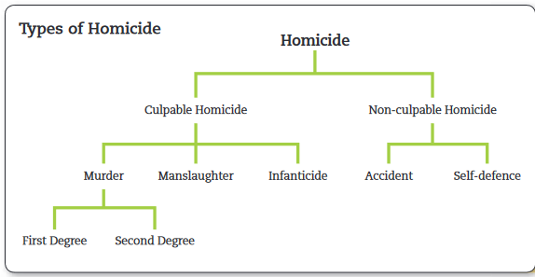

Slide 10
Murder
Murder is defined as the _____________________________________________.
Murder is usually identified by a clear intent to kill, but sometimes can be the result of someone’s reckless actions (i.e. a person sets a house on fire while they are aware that there are people inside)
In Canada, murder is divided into two subcategories:
____________________________
____________________________

Slide 11
First versus Second-Degree Murder
First-degree murder is ____________________________________.
It occurs when:
The murder is ____________________________________
The victim is a law enforcement agent, such as a ____________________________________________________________________.
The death occurs while another crime is simultaneously committed (i.e. a bank robber kills a guard even if they didn’t mean to, still a first-degree murder because it happened at the same time as the robbery.)
All other murders are considered _____________________________________________.

Slide 12
Murder Sentencing
The minimum sentence for both first and second-degree murder is _____________________________________________ in Canada.
The difference between the two is _____________________________________.
Someone convicted of first-degree murder is eligible for parole only after _________________________________.
For second degree, the person may be eligible for parole after ________________.

Slide 13
Manslaughter
Manslaughter is ________________________________________________________________________________.
Manslaughter is not murder, and requires only general intent.
Ex: Sidney loses control of her car while speeding and kills a pedestrian, she could be charged with manslaughter, not murder. Although she was speeding, there was no intent to kill.
If Sidney had sped up and swerved at the pedestrian, there would be clear intent, and she would be charged with murder.

Slide 14
When Murder becomes Manslaughter
Sometimes people who are changed with murder can get downgraded to a conviction of manslaughter.
This happens when the accused uses one or two defences:
_________________________
__________________________

Slide 15
Manslaughter: Provocation
The accused must be able to prove that their actions happened “in the heat of passion caused by sudden provocation.”
Provocation must be a wrongful act or insult and must be something that would cause ____________________________________________.
Finally, the killing must take place during the loss of self-control (in the heat of the moment)
If the killing took place at a later time and was planned, then it would be _______________________.

Slide 16
Manslaughter: Intoxication
Being drunk or high can affect a person’s ability to predict the consequences of their actions.
If there is a doubt as to whether the accused specifically intended to kill the victim because the accused was drunk or high, the accused must be found guilty of ________________________________________________.
The Crown would have to prove that there was a specific intent and plan to kill the victim in order to get a murder charge if the accused was intoxicated.

Slide 17
Assisted Suicide
It is against the law in Canada to encourage someone to commit suicide, or to assist them in the act of suicide.
Until 1972, it was actually against the law to commit suicide, and those who were unsuccessful in their attempts were often prosecuted.
Some chronically ill Canadians have argued that they should have the right to get assistance in committing suicide, while other people argue that __________________________________________________.
While suicide and attempted suicide are now decriminalized, assisted suicide remains a ________________________________________.

Slide 18
Euthanasia
There is a very fine line between assisted suicide and euthanasia.
Assisted suicide would be when a person intentionally takes their life, with the ________________________________________.
Euthanasia would be when a person assists a terminally ill patient to end their life ___________________________________________.
Ex: A person with terminal cancer has expressed their wish to die by choosing not to undergo aggressive chemotherapy. Under these circumstances, ending their life would be called voluntary euthanasia. This could also happen if that person were in an irreversible coma. In that case, an immediate family member would consent to euthanasia on their behalf.

Slide 19
Assault
In Canada, there are three levels of assault, based on the level of severity and corresponding penalties:
Level one: ____________________
Level two: __________________________
Level three: _____________________________
All three levels of assault must have these two things in common:
The accused must have intent to assault and cause harm.
There must be no consent from the victim (i.e. in a boxing match there is consent by all parties, whereas an attack would have no consent by one party)

Slide 20
Level One Assault
Level One consists of any of the following actions:
Applying intentional force to another person without that person’s consent (i.e. _____________________________________________)
Attempting or threatening, by an act or gesture, to apply force against someone (i.e. _____________________________________________________________)
Approaching or blocking the way of another person (i.e. ___________________________________________________________________)
Harmful words are not assault. The words must be accompanied by a gesture. (i.e. a verbal threat to hurt someone is not assault)

Slide 21
Level Two Assault
Level Two: Assault causing bodily harm
Generally involves a physical attack with a ____________________________________________________________________________.
The attack usually causes _____________________________________________________.
Assault causing bodily harm carries a maximum penalty of _____________________________________.

Slide 22
Level Three Assault
Level Three: aggravated assault
This is an attack so severe that the physical injuries may _____________________________________________________________
It is committed if a person _______________________________________________________________________________________________________________________________________________________________.
The maximum penalty is ___________________________________________________.

Slide 23
Sexual Assault
Sexual assault is a specific form of assault that involves any form of unwanted sexual activity, or when _________________________________________________.
There are three levels of sexual assault in Canada:
Level One Sexual Assault
Level Two Sexual Assault
Level Three Sexual Assault
These levels are parallel to the three levels of assault.

Slide 24
Level One Sexual Assault
Level one sexual assault is when the accused applies intentional force to another person with the ______________________________________.
This could involve ___________________________________________________________.
Maximum penalty: ______________________________________.
Ex: molestation offence - __________________________________________________.

Slide 25
Level Two Sexual Assault
Level two involves sexual assault with a weapon or an imitation weapon, threats, or causing bodily harm to the victim with the intent of engaging in sexual acts.
Maximum sentence: __________________________________________.

Slide 26
Level Three Sexual Assault
Level three is the most severe form of sexual assault.
Also known as __________________________________________________________.
The Criminal Code defines it as a sexual attack so serious that the victim’s _____________________________________________________________________________.
Maximum sentence: ___________________________________________.

Slide 27
Consent
As defined in the criminal code, consent is the ______________________________________________________________________________.
Since 1999, the Supreme Court has not allowed “implied consent” as a form of consent. The words _________________________________________________________ in order for consent to be granted or denied.
Intoxication is not a defence if the accused was too intoxicated to control their actions. In other words, ________________________________________________________________________________________________________________________________________________________________.

Slide 28
Age of Consent
Age of consent is the legal age in which a person can ___________________________________________________________________________.
Two centuries ago, the legal age for consent was ___. It was changed to ___ in the year 1892, and then to ___ in 2008.
Where there is a relationship of trust, authority or dependency (such as a coach, teacher, or doctor) the age of consent is ____.
There is a “peer group” exception: when two people are less than a year apart, and under 16, they are able to provide consent to one another. (i.e. a 14 and 15 year old can grant consent to one another, but a 14 year old cannot give consent to a 16 year old)

